Slide 1


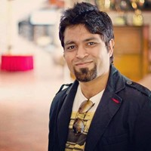


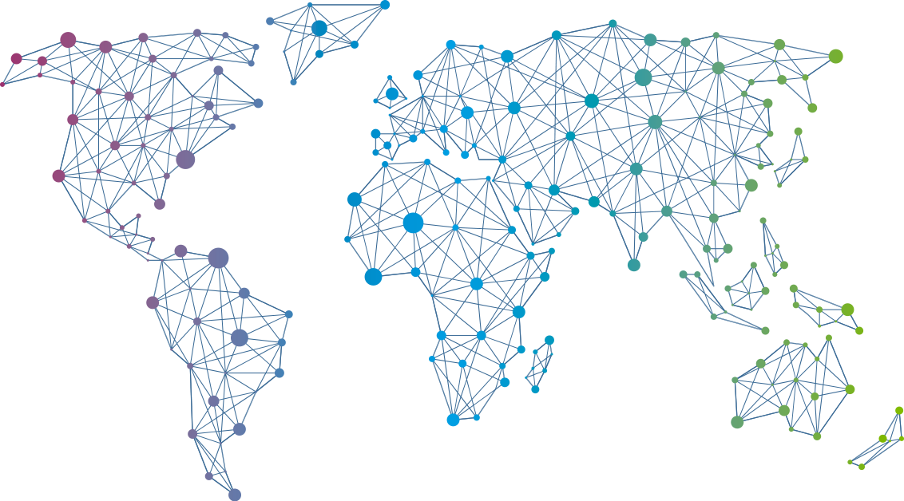

Speaker
Mohit Chhabra
Secure your Infrastructure with Azure Sentinel
Mohit Chhabra
mohit_techy
September 16th & 17th
^{Online Event}
Powered By
International Conference

